Slide 1
DEEP LEARNING
The CNN challenge
Jose Antonio Ruiz Heredia
Hector Carlos Flores Reynoso
Alvaro Honrubia

Slide 2
THE PROBLEM
Problem
Scope
Observations
Given a set of images (224px, 224px) create a classifier that is able to detect the vehicle type
Refine the Convolutional Neural Network and optimize its parameters
Models are compared using metrics such a mean accuracy, recall and precision

Slide 3
THE PROCESS
00
01
02
03
Convolutional Layer Parameters
Strides
Batch Normalization
Bias_initializer
Kernel_size
Adding
Convolutional Layers
Two
Three
Four
Six
Data Augmentation
rotation_range
width_shift_range
height_shift_range
zoom_range
Base Model

Slide 4
MODEL ARCHITECTURES
00
01
02
03
Base Convolutional
filters(32)
stride(1,1)
bias_initializer("zeros")
kernel_size(1,1)
Changing stride
stride (2,2)
stride (3,3)
Batch Normalization
Changing kernel_size
kernel_size (3,3)
kernel_size(5,5)
04
05
06
07
Three Convolutional
batch_size reduced to 32
kernel_size(3,3)
GlobalAveragePooling2D
Four Convolutional
LeakyReLU
SpatialDropout2D
Six Convolutional
Layers with filters 64, 128, 256, 256, 512, 512
Data Augmentation
rotation_range = 30
width_shift_range = 0.2
height_shift_range = 0.2
zoom_range = 0.1

Slide 5
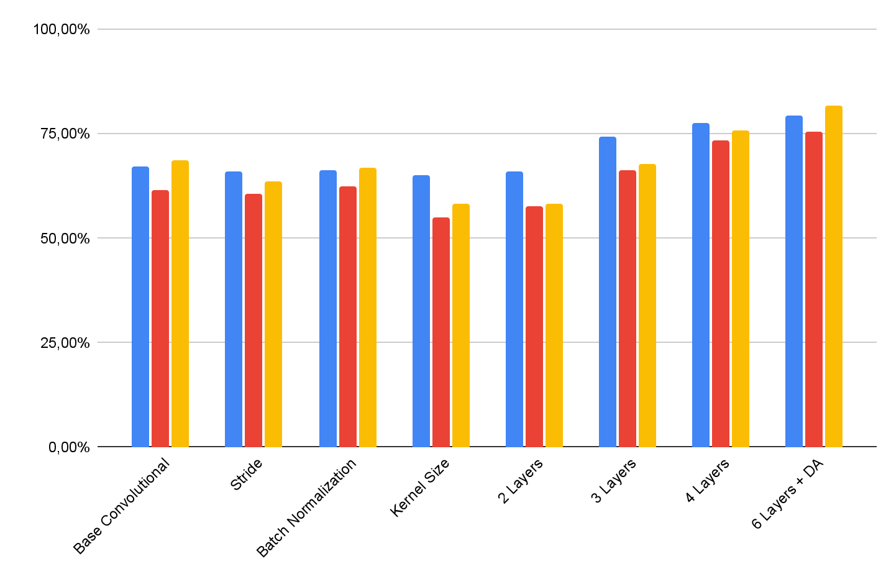
MODEL METRICS
BEST MODEL
Mean accuracy: 79.28%
Mean recall: 75.64%
Mean precision: 81.83%
Accuracy
Recall
Precision

Slide 6
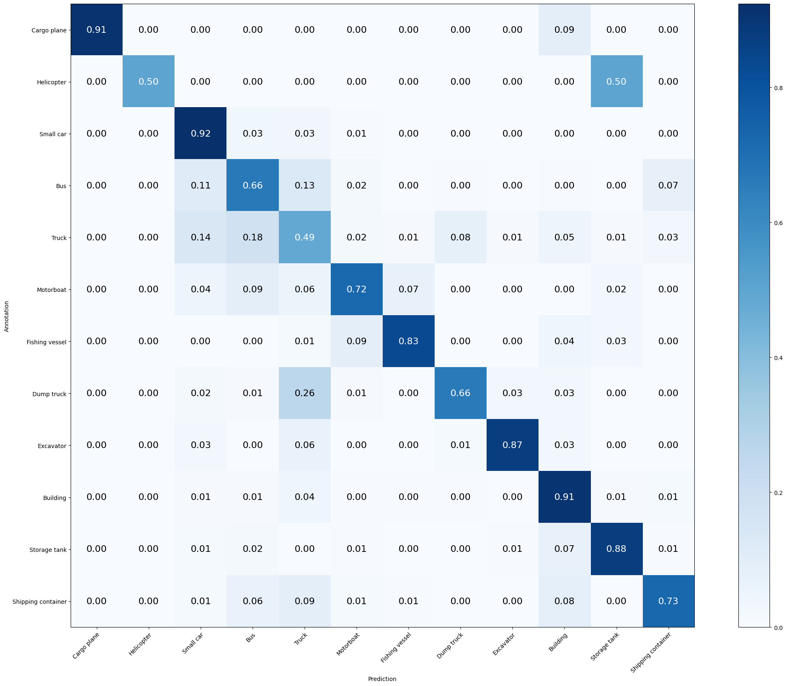
BEST MODEL
Mean Accuracy: 79.280%
Mean Recall: 75.642%
Mean Precision: 81.839%
> Cargo plane: Recall: 91.176% Precision: 100.000% Specificity: 100.000% Dice: 95.385%
> Helicopter: Recall: 50.000% Precision: 100.000% Specificity: 100.000% Dice: 66.667%
> Small car: Recall: 92.381% Precision: 83.441% Specificity: 95.518% Dice: 87.684%
> Bus: Recall: 66.210% Precision: 61.966% Specificity: 95.362% Dice: 64.018%
> Truck: Recall: 48.679% Precision: 52.869% Specificity: 93.860% Dice: 50.688%
> Motorboat: Recall: 71.910% Precision: 71.910% Specificity: 98.780% Dice: 71.910%
> Fishing vessel: Recall: 83.117% Precision: 85.333% Specificity: 99.466% Dice: 84.211%
> Dump truck: Recall: 65.812% Precision: 75.490% Specificity: 98.763% Dice: 70.320%
> Excavator: Recall: 87.179% Precision: 90.667% Specificity: 99.660% Dice: 88.889%
> Building: Recall: 90.927% Precision: 89.662% Specificity: 96.833% Dice: 90.290%
> Storage tank: Recall: 87.582% Precision: 92.414% Specificity: 99.446% Dice: 89.933%
> Shipping container: Recall: 72.727% Precision: 78.322% Specificity: 98.438% Dice: 75.421%

Slide 7
CONCLUSIONS
Data Augmentation Improves Generalization
Progressive Convolutional Feature Extraction
GlobalAveragePooling for Efficiency
Extract low-level features in early layers and high-level patterns in deeper layers
Forces the model to learn more robust features instead of memorizing the training data.
Replacing Flatten() with GlobalAveragePooling2D() reduces the number of parameters while retaining spatial information

